Slide 1
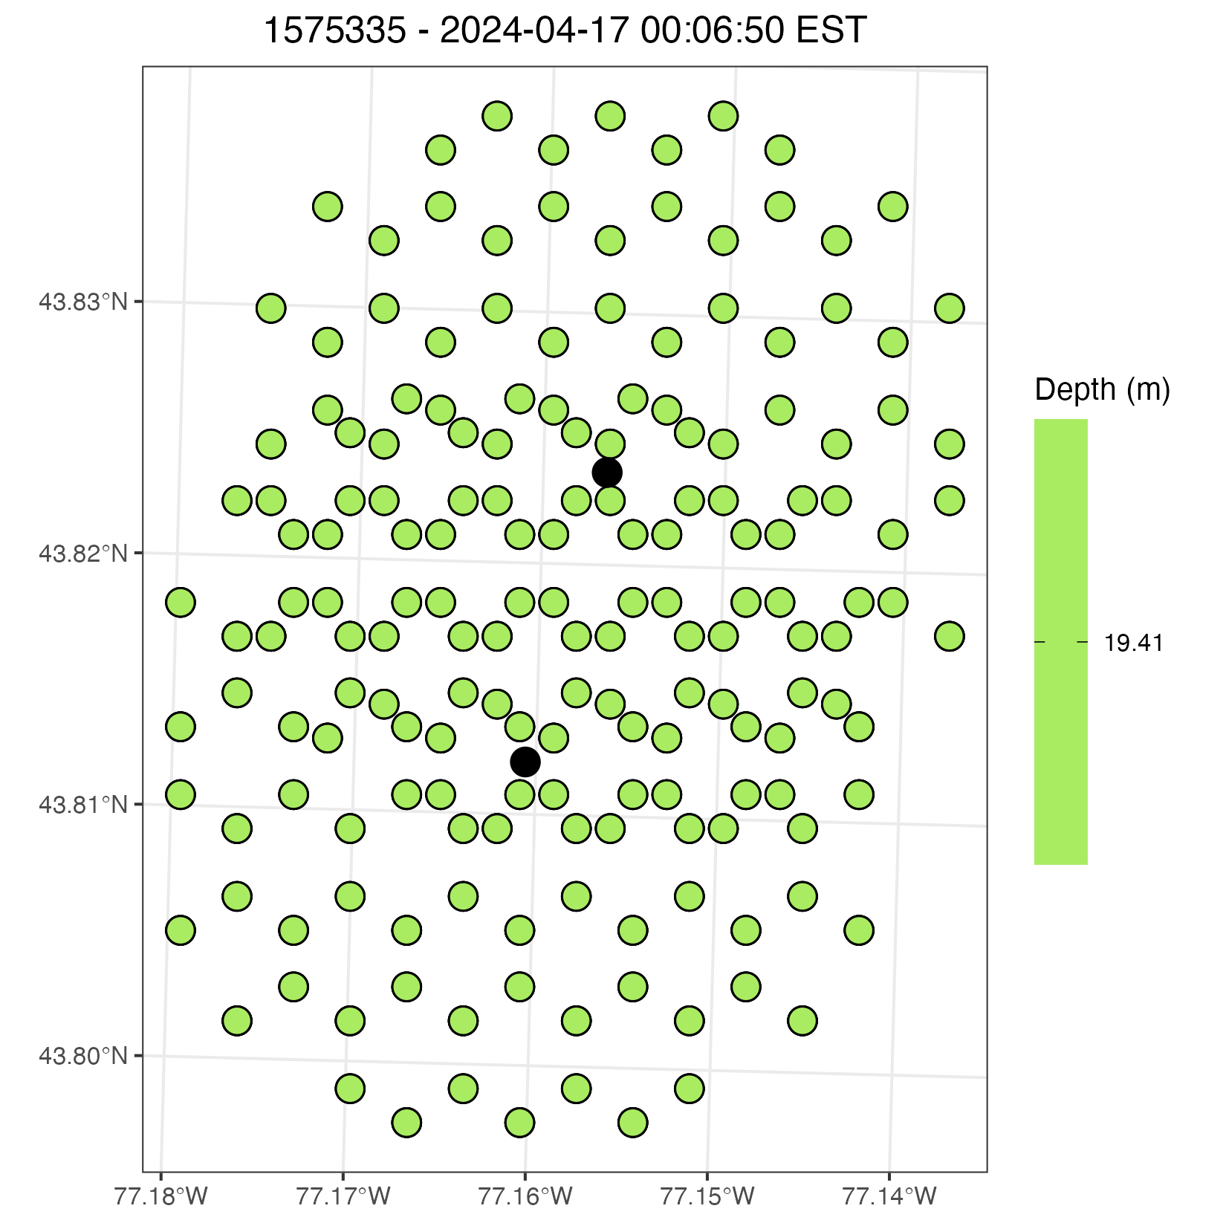
Detection for 1 fish on Point Peter Line – Blackdots represent receivers – green dots are where the fish could be – it had a depth of 19.41 m – the fish’s location is based on an equally spaced grid but could be randomly sampled

Slide 2
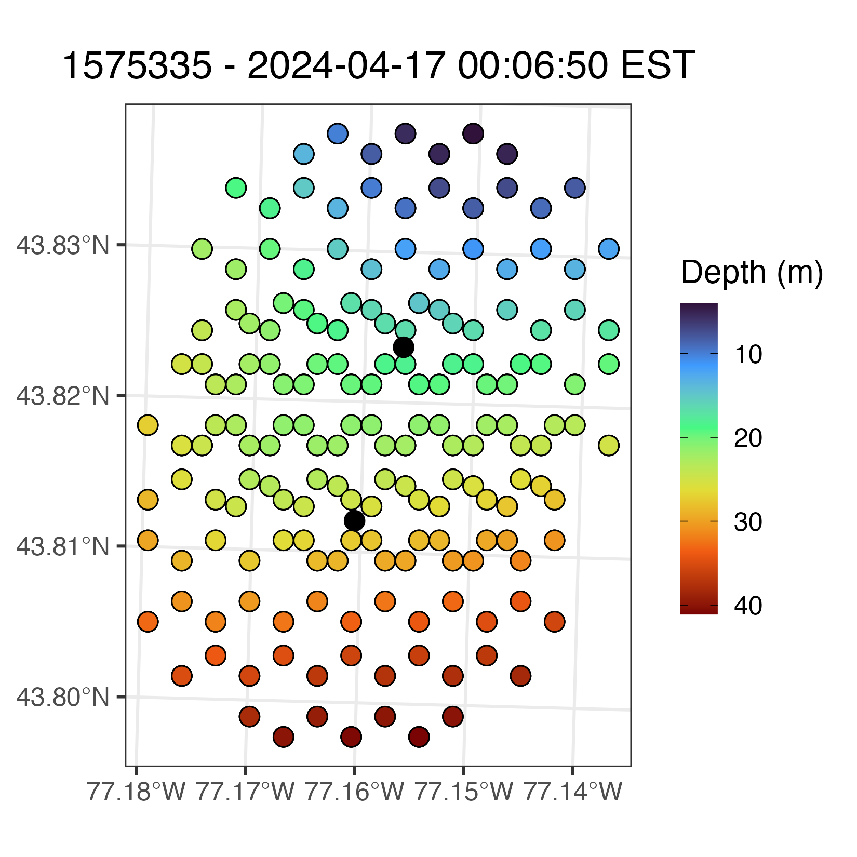
Bathymetry of the lake given the potential location of the fish.

Slide 3
Bathymetry of the lake given the potential location of the fish.
This is what I had considered: what area of the detection radius is <19.41m? In this example, about 40% for the top receiver (and very low (<5%) for the bottom receiver). So (40+5) /2 = 22.5% benthic vs 77.5% suspended. NOTE as discussed, I would make benthic depth plus 5m (or some small margin) so the fish can be associated with the bottom, without actually having to touch it! (so my area should be 24.41m and thus ratios would skew accordingly.

Slide 4
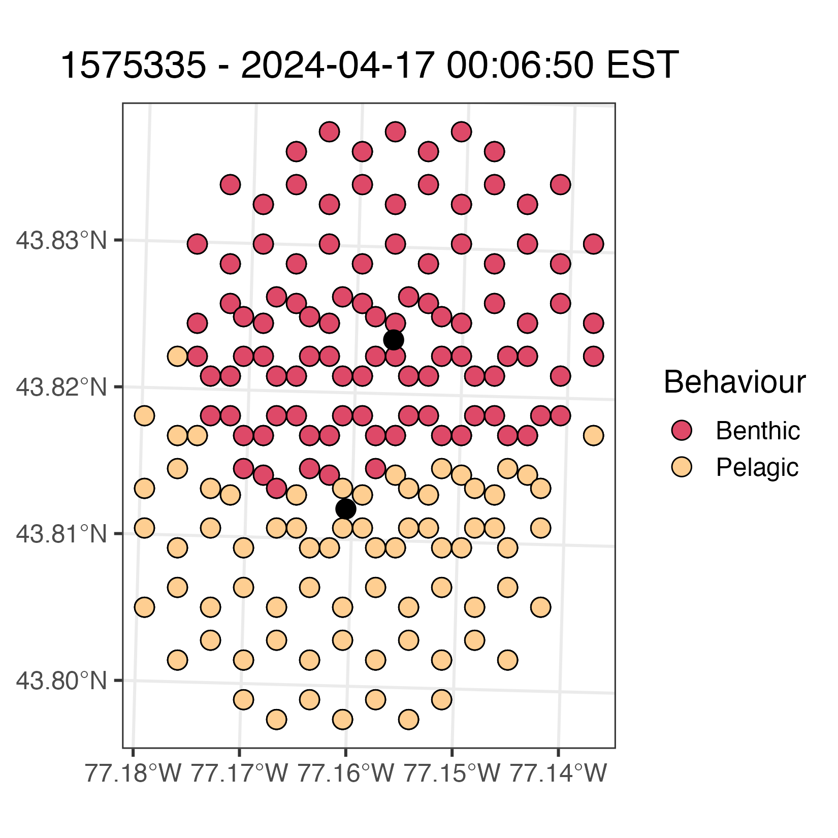
Given the bathymetry and fish’s depth we can classify the fish to be either benthic or pelagic at the given grided locations – again I can easily do this process for random points within the receiver range.

Slide 5
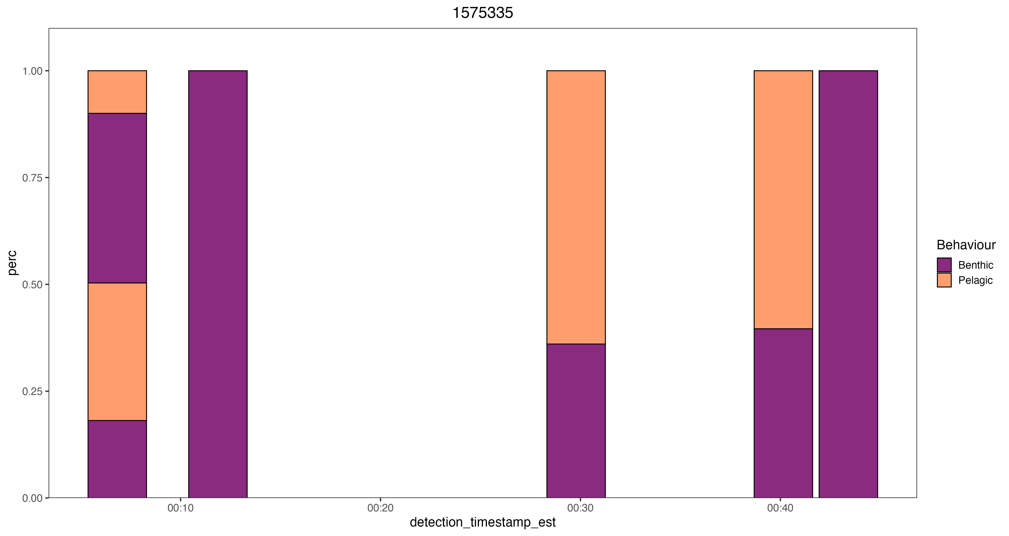
Example of 5 detections including the one used above – total percentage is from 0-1.
PPW-008
PPW-008
PPW-008
PPW-004
PPW - 006
PPW - 006
PPW - 008
PPW - 008

Slide 6
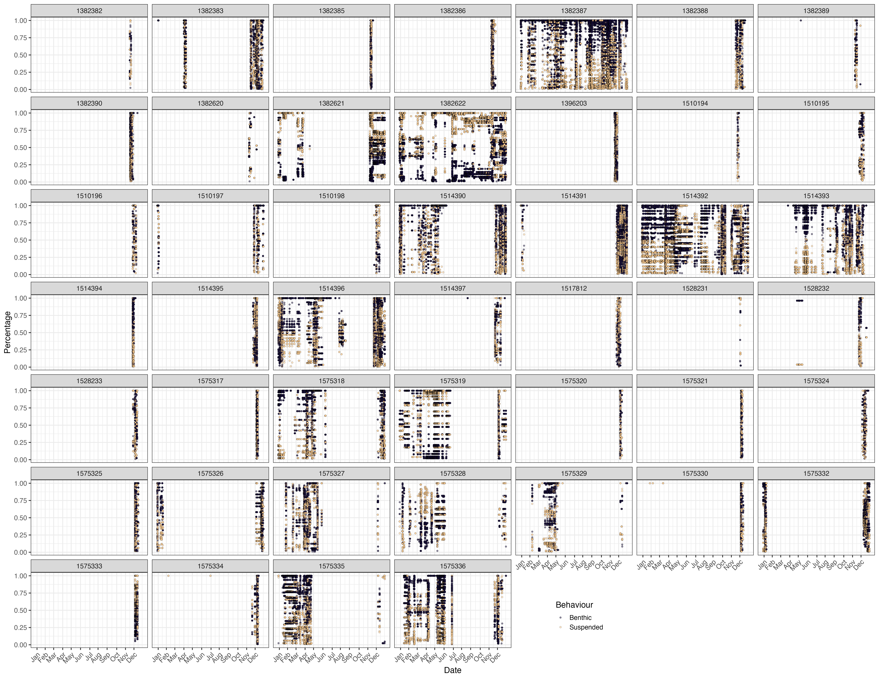
If I do this for each detection and each fish I get the following

Slide 7
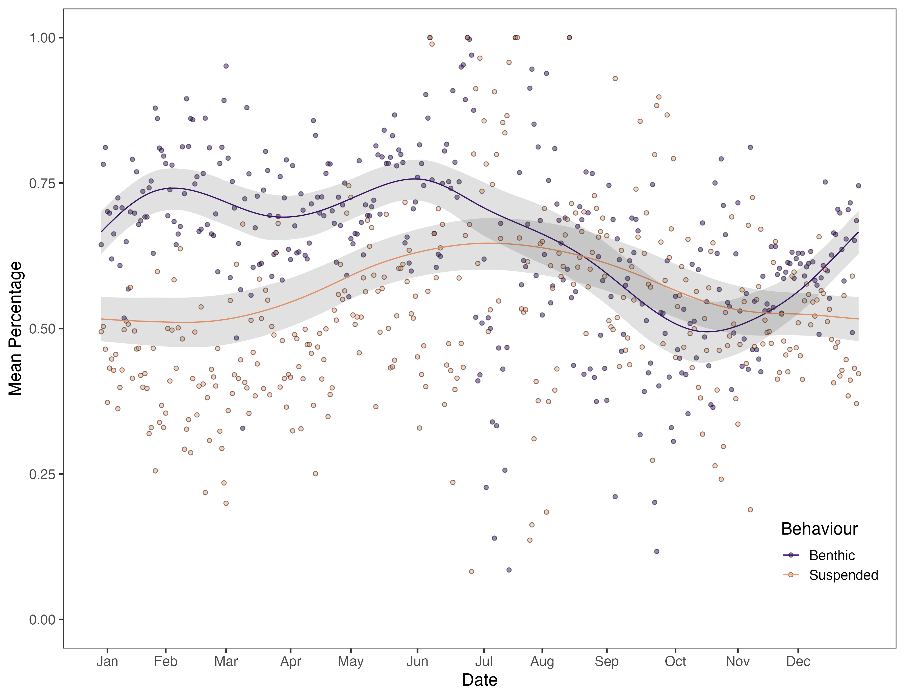
From there I have taken the average for each fish given each day it was detected, can go more fine scale than this – The model figure, is mean percentage with a response of day of year, benthic or pelagic, and a random effect of fish id. The points are the mean regardless of individual – This overall analysis can change as right now I’m not sure I find it all that informative or at least the way I’m presenting it as it right now the Daily percentage a fish could be benthic or pelagic. Sorry for the inconsistencies in the labelling of things.

